Slide 1
Textures
Hosein Ghahremanzadeh
Notes:
The background is a sample of volumetric lighting in my own 3D graphics engine, HG3D

Slide 2

Textures
Texture are used to pass data from the user of the program to program.
Textures most of the time are used as read only memory inside shaders.
A texture hold one or more images.
An image has a certain dimensionality, a certain size and a certain type.
There are number of different types for textures as well.
Notes:
We will mostly discuss the 2D and 3D textures which are single simple 2D and 3D images.

Slide 3
Textures Image
An image is a 1D, 2D, or 3D array of elements.
Each element has a type, and can be a vector.
The component count of the vector is part of the image type, which can be 1, 2 , 3, or 4.
An image is accessed via two normalized coordinates.

Slide 4
Textures Image
There are several ways to access data on an image.
An image is a matrix of values, the access is done via normalized real values.
Access to real coordinates means one can access between elements of an image.
To handle real coordinate access there are two ways:
Interpolate between nearest elements
Choosing the nearest element

Slide 5
Textures Image
Some times the level of details (LOD) being displayed is less that the LOD of the image itself (the image is minified).
Minifying can cause discontinuity in the drawn image.
To resolve minifying problems, mipmaps are generated.
Mipmaps are lower detail images of the original image.
Each mipmap has half the resolution (on each dimension) of the previous mipmap level.
The first level (level 0) is the original image.
Notes:
Mipmaps are either generated offline and given to texture on runtime, or generated at runtime.

Slide 6
Textures Image
Accessing data on an image is more complex in the case of minifying and presence of mipmaps.
To select a mipmap to be accessed there are two choices:
Select the nearest mipmap to the LOD.
Interpolate between two nearest mipmaps to the LOD.
To access data on each mipmap the same two choices of accessing a simple images are available:
Select the nearest element to the accessed coordinate.
Interpolate between nearest elements.
Notes:
Mipmaps are either generated offline and given to texture on runtime, or generated at runtime.
For better quality it is recommended to interpolate between mipmaps and the elements.

Slide 7
Textures Image
In some cases texture is accessed in a way that the LOD of the access is higher than the LOD of the image itself, this case is known as magnifying.
The access method does not change in this case.
Notes:
Since there is not much we can do about this case, the same two access method for the simple images are available here.

Slide 8
Textures Image
Some times access happens out of the accessible normalized range.
This access could be clamped to edges or wrapped around.
Both option are available per dimension.

Slide 9
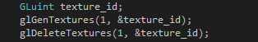

Textures
Textures are OpenGL objects, and like any other OpenGL objects are to be created and deleted.
$glGenTextures$ function creates textures.
$glDeleteTextures$ function deletes textures.
Notes:
$glGenTextures$ function receives the count of textures to be created and a pointer to an array to which the IDs of the created textures is written.
$glDeleteTextures$ function receives the count of the textures to be deleted and a pointer to the array containing the IDs of the textures to be deleted,

Slide 10
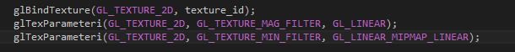

Textures
To set a texture’s state the texture must be bound.
$glBindTexture$ function binds a texture.
$glTexParameter∗$ set of functions are used to set texture parameters, such as access methods and mipmap generation.
We’re mostly interested in $glTextParameteri$ which sets integer parameters of a texture.
Notes:
The first parameter is the texture type of the target texture.
Binding to zero will unbind the currently bound texture.
The $glBindTexture$ function receives the target type, and a texture ID and binds the texture.
There is a set of $glTextureParameter∗$ functions that have the same behavior with the difference that they accept the texture id as a parameter and do not require the texture to be bound.
$glTexParameter∗$ functions’ first parameter describes the target texture type, the second parameter is the parameter’s name, and third parameter is the value for the parameter to be set to.

Slide 11
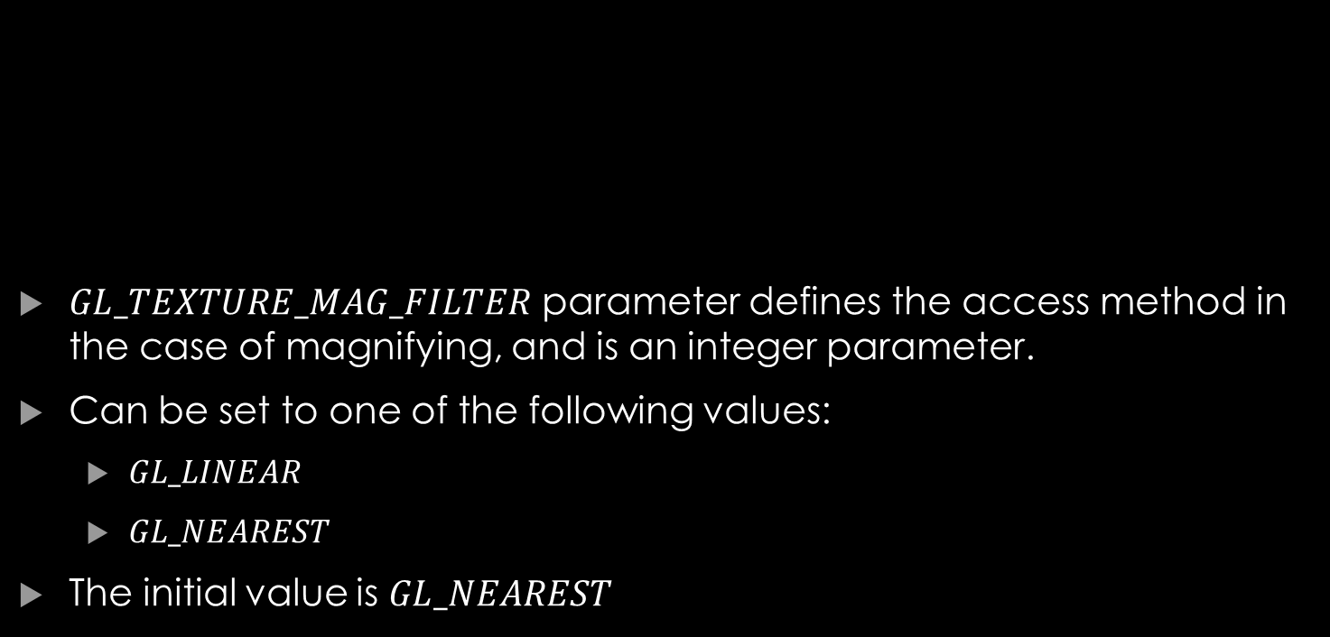
Textures Parameters
$GL_TEXTURE_MAG_FILTER$ parameter defines the access method in the case of magnifying, and is an integer parameter.
Can be set to one of the following values:
$GL_LINEAR$
$GL_NEAREST$
The initial value is $GL_NEAREST$

Slide 12
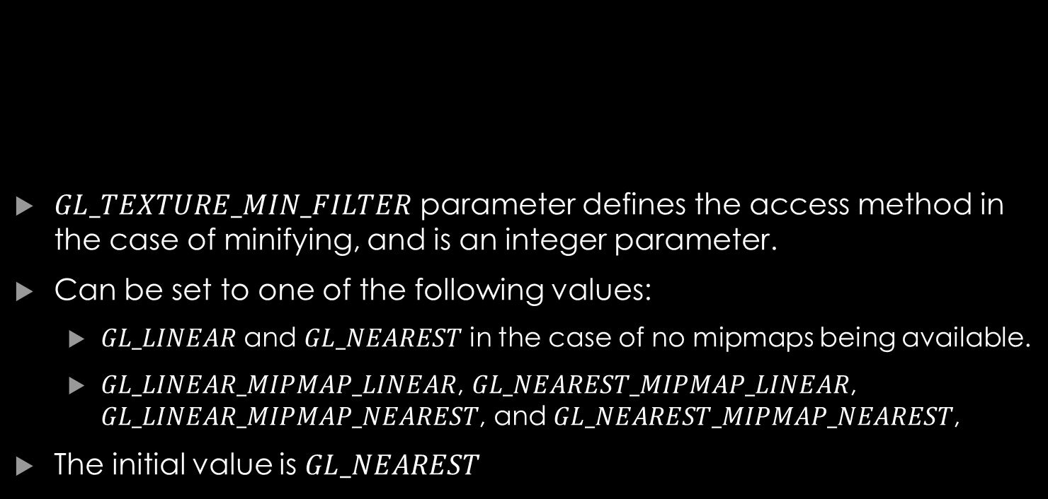
Textures Parameters
$GL_TEXTURE_MIN_FILTER$ parameter defines the access method in the case of minifying, and is an integer parameter.
Can be set to one of the following values:
$GL_LINEAR$ and $GL_NEAREST$ in the case of no mipmaps being available.
$GL_LINEAR_MIPMAP_LINEAR$, $GL_NEAREST_MIPMAP_LINEAR$, $GL_LINEAR_MIPMAP_NEAREST$, and $GL_NEAREST_MIPMAP_NEAREST$,
The initial value is $GL_NEAREST$

Slide 13

Textures Parameters
$GL_TEXTURE_MIN_FILTER$ parameter defines the access method in the case of minifying, and is an integer parameter.
Can be set to one of the following values:
$GL_LINEAR$ and $GL_NEAREST$ in the case of no mipmaps being available.
$GL_LINEAR_MIPMAP_LINEAR$, $GL_NEAREST_MIPMAP_LINEAR$, $GL_LINEAR_MIPMAP_NEAREST$, and $GL_NEAREST_MIPMAP_NEAREST$,
The initial value is $GL_NEAREST$.

Slide 14

Textures Parameters
$GL_GENERATE_MIPMAP$ parameter defines whether mipmap is to be generated when data is assigned to texture of not.
Can be set to $GL_TRUE$ or $GL_FALSE$.
The initial value is $GL_FALSE$.

Slide 15
Textures Parameters
$GL_GENERATE_MIPMAP$ parameter defines whether mipmap is to be generated when data is assigned to texture of not.
Can be set to $GL_TRUE$ or $GL_FALSE$.
The initial value is $GL_FALSE$.

Slide 16
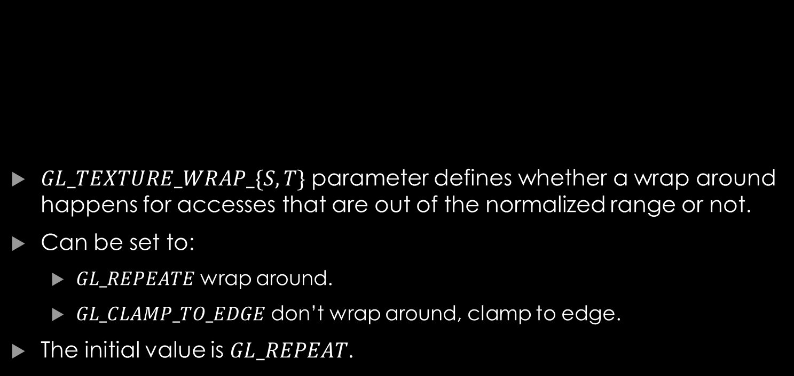
Textures Parameters
$GL_TEXTURE_WRAP_\{S, T\}$ parameter defines whether a wrap around happens for accesses that are out of the normalized range or not.
Can be set to:
$GL_REPEATE$ wrap around.
$GL_CLAMP_TO_EDGE$ don’t wrap around, clamp to edge.
The initial value is $GL_REPEAT$.
Notes:
The $GL_TEXTURE_WRAP_S$ is for the first dimension and $GL_TEXTURE_WRAP_T$ is for the second.

Slide 17

Textures Texture Image Data
$glTexImage∗$ is used to assign image data to a texture.
$glTexImage2D$ is used to assign 2D image data to a texture.
$glTexImage3D$ is used to assign 3D image data to a texture.

Slide 18

Textures 2D Textures
The texture consist of a single 2D image.
$glTexImage2D$ is used to assign 2D image data.
Notes:
$glTexImage2D$ function’s first parameter is the target texture type, here it is going to be $GL_TEXTURE_2D$.
Its second parameter is the LOD level, if mipmap generation is enable this is set to 0 (the base level) and if mipmaps are available from other source, proper value for each mipmap shall be assigned.
The third parameter, sets the internal format and the components of the image data (which can describe the component count, and component type and size).
Forth parameter and fifth parameter are width and height of the image data.
The sixth parameter is the width of the border of the texture which should be set to 0.
The seventh parameter is the image data format, and the eighth parameter is the type of the data.
The las parameter is a pointer to data.
$glTexImage3D$ Function is almost the same, except the additional depth parameter after the height parameter.

Slide 19

Textures Access in GLSL
To access texture in GLSL there is a specific type called $sampler$.
For 2D texture we use $sampler2D$.
The texture is assigned to a texture unit.
Then the ID of the texture unit is assigned to the sampler.
Texture now is accessible in shader via the sampler.
The sampler is usually defined as uniform and the texture unit ID is set to it as an integer.
Notes:
Samplers have different type depending on your texture. Here for float 2D texture we use $sampler2D$.

Slide 20
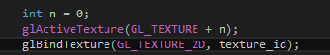

Textures Access in GLSL
To assign a texture to a texture unite, the texture unit must be activated this is done using the $glAcitveTexture$ function.
After activating the texture unit bind the textures. This will assign the texture to the texture unit.

Slide 21
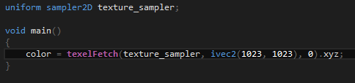

Textures Access in GLSL
To read a value from texture in GLSL there are two functions.
$texelFetch$: This function receives a texture sampler, a 2D integer vector, and the level of the LOD, and returns a 4D vector of the sampler type.
There will be no linear interpolation happening here since the texture coordinate is exact.

Slide 22
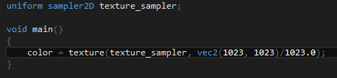

Textures Access in GLSL
$texture$ function reads value from texture using a sampler and real vertex coordinate.
The result is a 4D vector and the value that are not in the texture are set to 0.

Slide 23

Your questions

Slide 24
Helpful links
https://www.khronos.org/registry/OpenGL-Refpages/gl4/html/glTexParameter.xhtml (glTexParameter*)
https://www.khronos.org/registry/OpenGL-Refpages/gl4/html/glTexImage2D.xhtml (glTexImage2D)
https://www.khronos.org/registry/OpenGL-Refpages/gl4/html/glTexImage3D.xhtml (glTexImage3D)
https://www.khronos.org/registry/OpenGL-Refpages/gl4/html/texelFetch.xhtml (texelFetch)
Notes:
https://www.khronos.org/opengl/wiki/Data_Type_(GLSL) (GLSL types)
https://www.khronos.org/opengl/wiki/Built-in_Variable_(GLSL) (GLSL built-in variables)

